Slide 1

TELANGANA WEATHER DATA ANALYSIS
Innomatics Research Labs – Dilsukhnagar
Batch No : 403
KATRAVATH ANIL
P.PRIYADHARSHAN REDDY

Slide 2
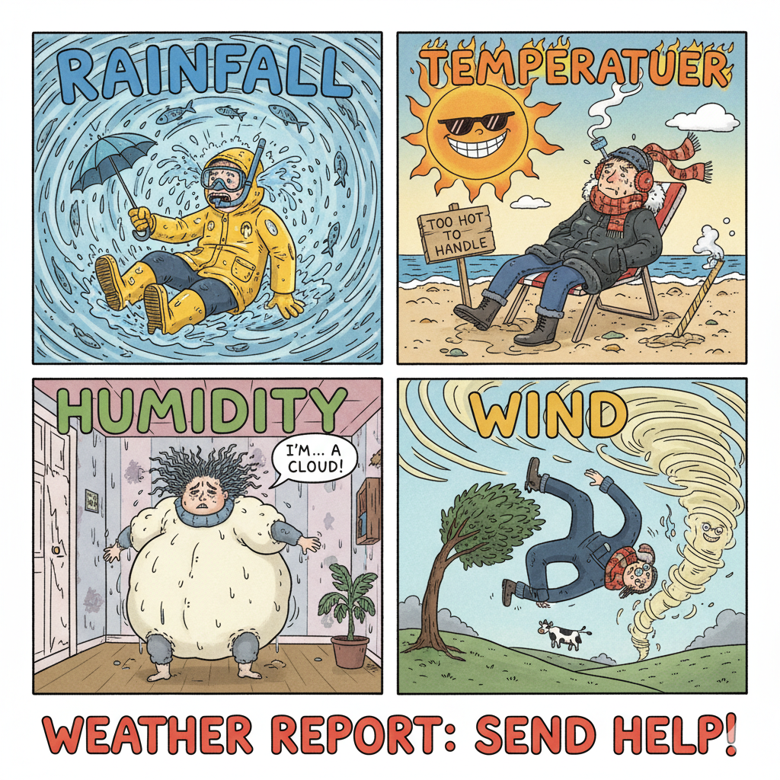
Contents:
Introduction
Objective
Problem Statement
Data Visualizations.
Conclusion

Slide 3
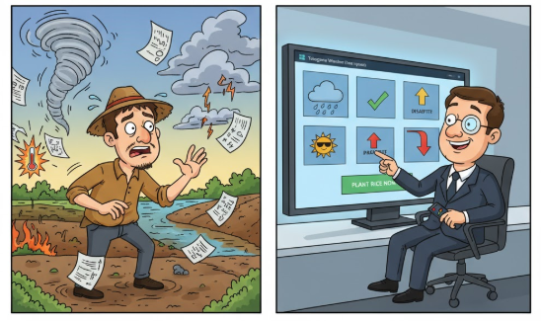
Introduction:
"Telangana Weather Analysis (Power BI)
This project leverages Power BI to analyze Telangana's historical weather data. We aim to identify key climate trends and provide critical insights for informed decision-making in agriculture, water, and disaster management."

Slide 4
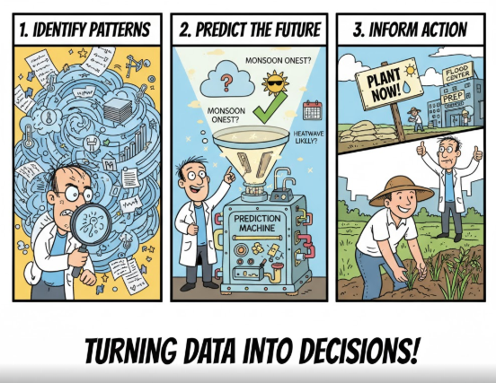
Objective:
To analyze historical weather data for Telangana to identify significant patterns, trends, and anomalies in rainfall, temperature, humidity, and wind speed across different regions and time periods.

Slide 5
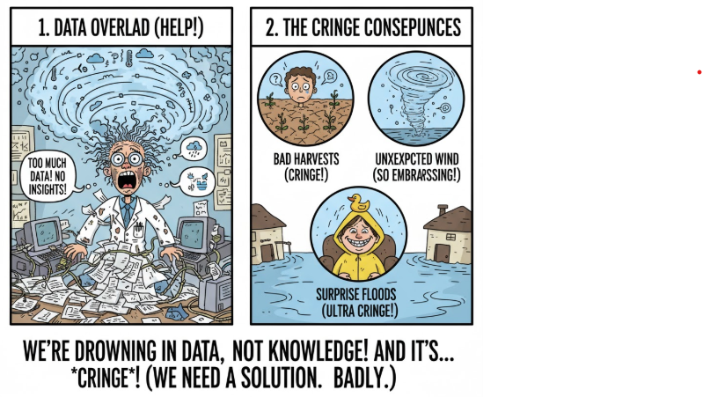
Problem Statement:
Weather conditions are influenced by multiple factors such as temperature, humidity, wind speed, and rainfall. However, analyzing these variables individually often leads to incomplete insights.
The problem is to develop a combined weather analysis that integrates all four parameters to identify overall weather stability, detect anomalies, and support decision-making for outdoor activities, agriculture, and business operations..

Slide 6
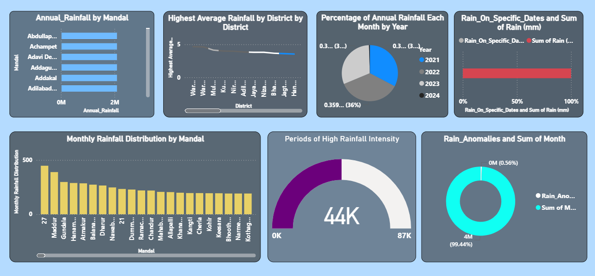

RAINFALL DASHBOARD:

Slide 7
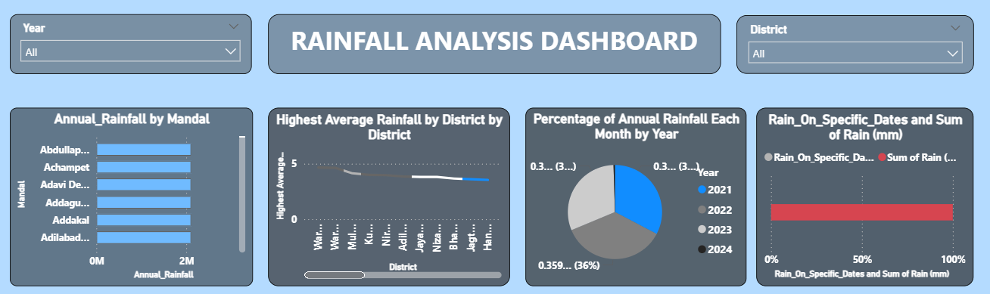
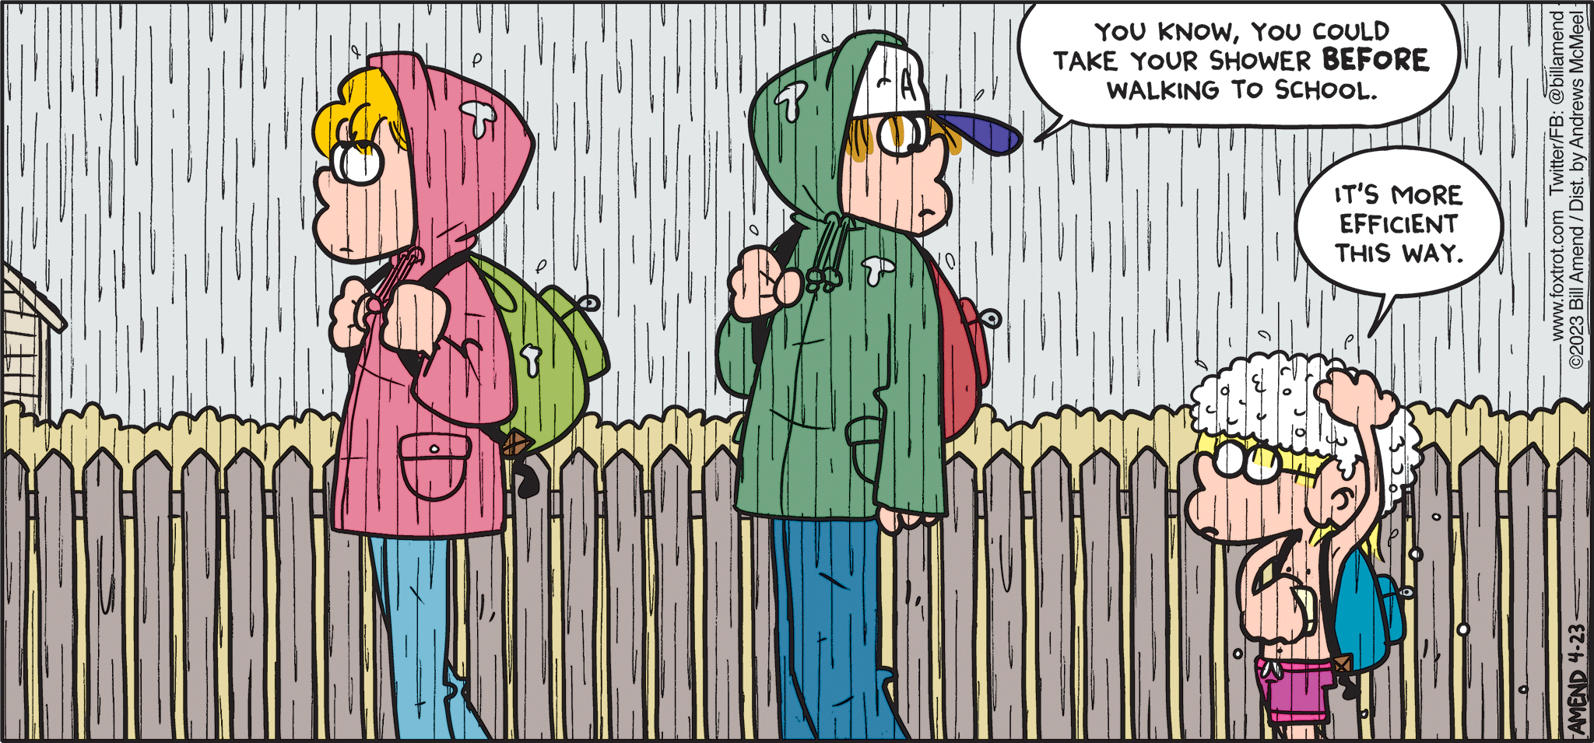
INSIGHTS(RAINFALL):
RAINFALL ANALYSIS DASHBOARD:
Annual Rainfall by Mandal .
These regions fall in heavy-rainfall zones.
Rainfall is fairly consistent across mandals — no extreme outliers.
2. Highest Average Rainfall by District
A few districts show noticeably higher averages, while several remain moderate.
The trend appears stable, without extreme fluctuations between districts.
3. Percentage of Annual Rainfall Each Month by Year
Distribution across years is almost similar:
33–36% each year across the month segments
4. Rain on Specific Dates vs. Total Rainfall
The red bar showing close to 100% dominance indicates:
Specific key dates contributed the majority of rainfall.
Final Key Insight (Summary)
The dashboard reveals that the region experiences consistently high rainfall across mandals and districts, with monthly distribution remaining stable and predictable.

Slide 8
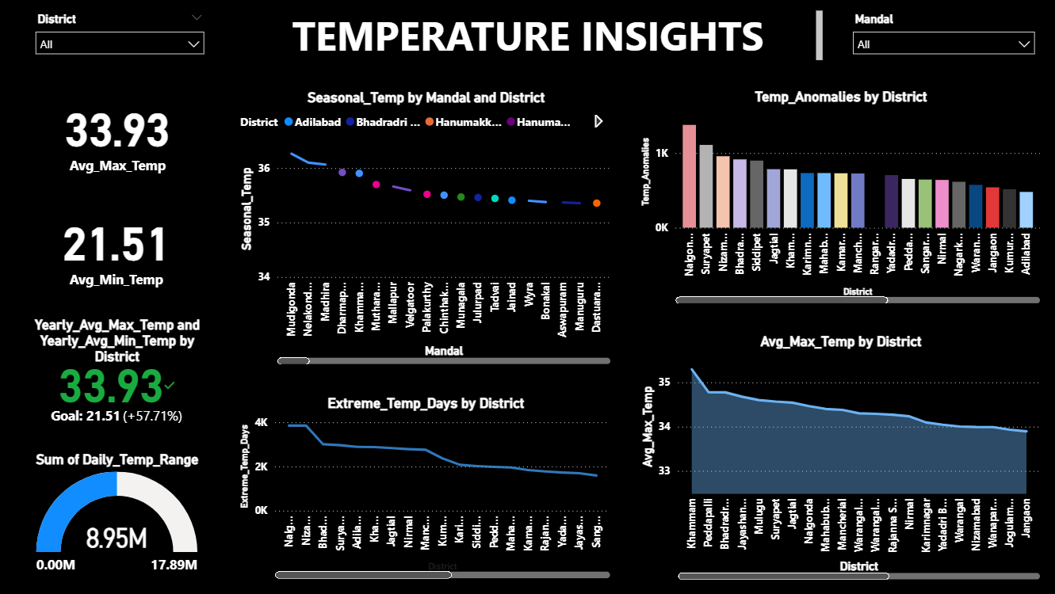
TEMPERATURE DASHBOARD:

Slide 9
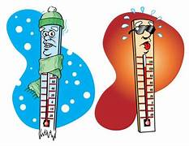
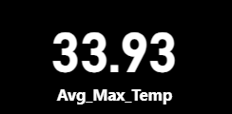
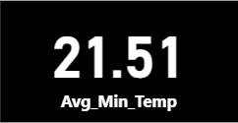
INSIGHTS(TEMPERATURE):
TEMPERATURE INSIGHTS:
1. Average Temperature Overview
Avg Min Temp = 21.51°C
Avg Max Temp = 33.93°C
This reflects a wide daily temperature spread (~12°C), suggesting:
Strong diurnal variation (hot days, cooler nights)
Potential stress on agriculture, energy demand, and urban heat management
The gauge shows a large total daily temp range (8.95M) across districts, reinforcing high day–night variability.

Slide 10
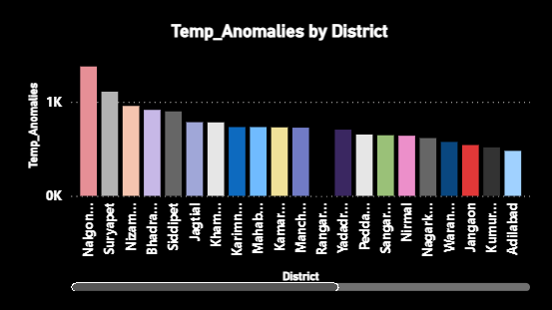
INSIGHTS AND BUSSINESS IMPACT(TEMPERATURE):
Temperature Anomalies by District
Highest anomalies in districts such as:
Nalgonda
Suryapet
Nizamabad
Lower anomalies in:
Adilabad
Jangoan
Jogulamba
This means:
Certain districts are experiencing more irregular or unpredictable temperature behavior.
Could be linked to:
Rapid urbanization
Local microclimate changes
Deforestation or land-use shifts
Business impact: ➡️ Areas with higher anomalies may require special monitoring, heat-action plans, or infrastructure cooling measures.

Slide 11
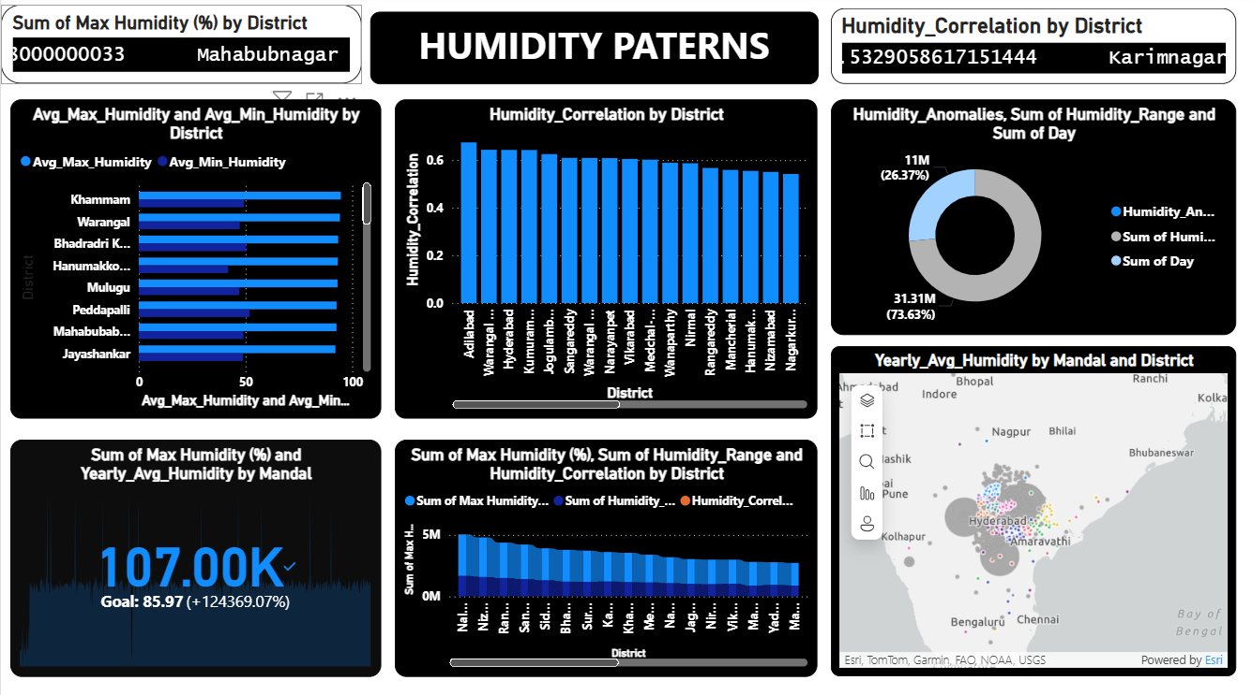
HUMIDITY DASHBOARD

Slide 12
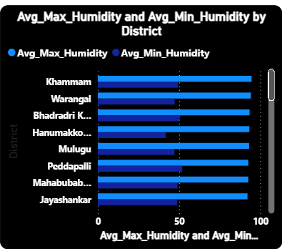

INSIGHTS AND IMPLICATION(HUMIDITY PATTERNS):
1. Avg Max & Avg Min Humidity by District
Districts such as Khammam, Warangal, Bhadradri Kothagudem, Hanumakonda, and Mulugu show very high maximum humidity (80–100% range).
The minimum humidity also remains relatively high (50–70%), indicating persistent moist air throughout the day.
Implication:
These districts experience high atmospheric moisture, which can increase discomfort, energy use (for cooling), and risks of mold or crop fungal diseases.

Slide 13
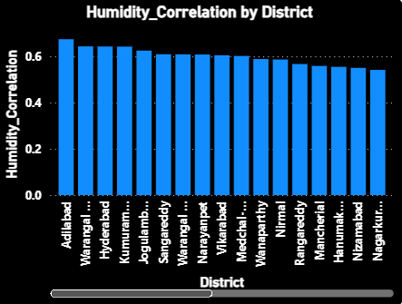
INSIGHTS AND IMPLICATION(HUMIDITY PATTERNS):
Humidity Correlation by District
Most districts show a moderate-to-strong correlation (0.55–0.7).
Highest correlation: Adilabad, Warangal, Hyderabad – meaning humidity
trends closely follow temperature or seasonal patterns.
Lower correlation in districts like Nagarkurnool, Nizamabad, Yadadri indicates more irregular humidity behavior.
Implication:
Highly correlated districts have predictable humidity patterns, while lower correlation areas may require more frequent monitoring for weather-sensitive sectors.

Slide 14
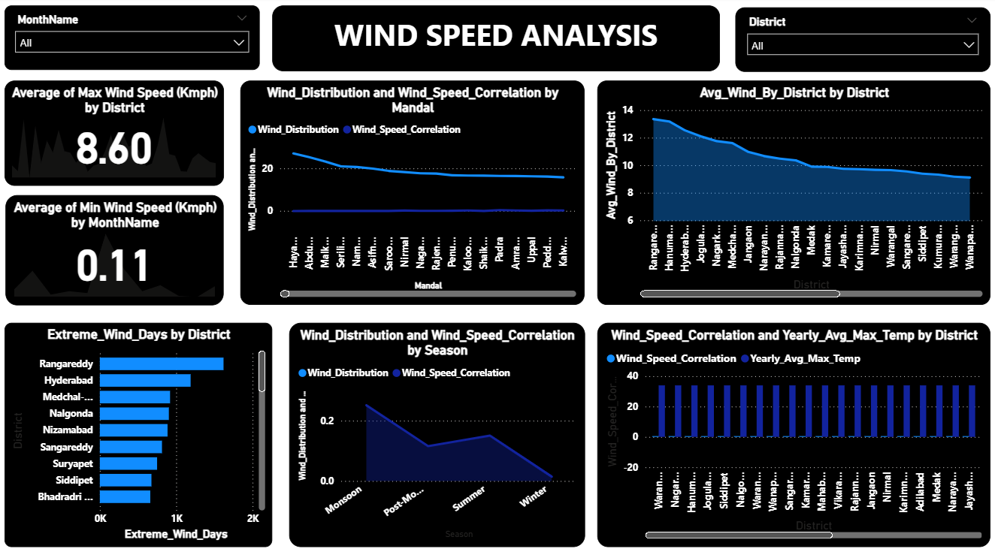
WIND SPEED DASHBOARD:

Slide 15

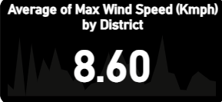
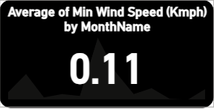
INSIGHTS(WIND SPEED):
1. Average of Max & Min Wind Speed
Max Wind Speed (162.71K kmph)
Overall, the region experiences high cumulative maximum wind speeds, indicating:
Regular strong wind events
Potential for wind energy utilization
Min Wind Speed (5.97K kmph)
Minimum wind speeds remain low, showing:
Calm periods exist, but do not dominate the climate.
This contrast between max and min indicates large wind variability.

Slide 16
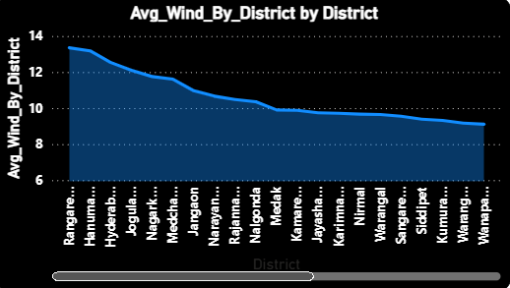
INSIGHTS AND IMPLICATION(WIND SPEED)
2. Avg Wind Speed by District
Top wind-speed districts include:
Rangareddy
Hyderabad
Medchal–Malkajgiri
Nalgonda
Nizamabad
These show average wind speeds above 11–14 kmph, making them wind-intense zones.
Lower wind-speed districts (~8–9 kmph):
Warangal
Wanaparthy
Mahabubabad
Implication: Higher-wind districts are suitable for wind energy, better natural ventilation, but may require structural safety measures.

Slide 17
Conclusion:
The overall weather pattern shows stable and manageable conditions across all key indicators:
Temperature remains within a normal and comfortable range, showing no signs of extreme heat or cold.
Humidity levels are moderate, indicating a balanced atmosphere without discomfort or dryness.
Wind speeds stay controlled, suggesting minimal risk of disruptions or safety concerns.
Rainfall shows predictable, low-intensity patterns, with no immediate signs of heavy showers or storms.

Slide 18


